Slide 1
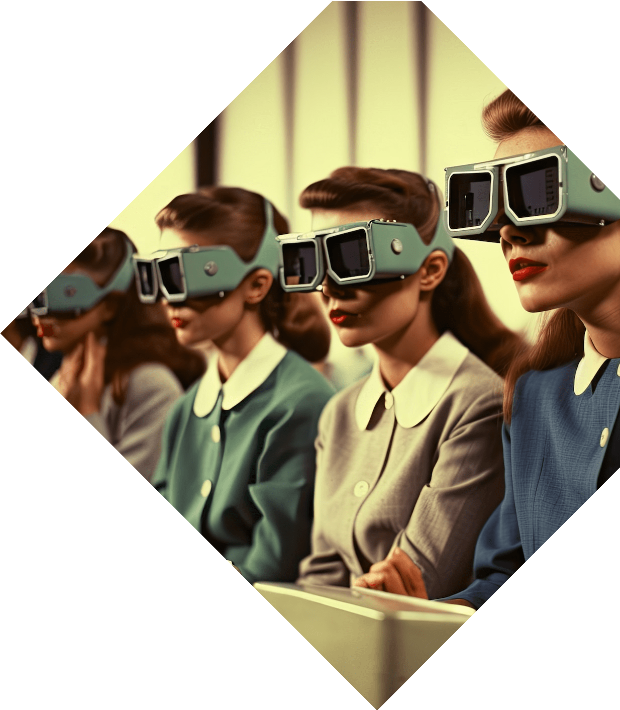
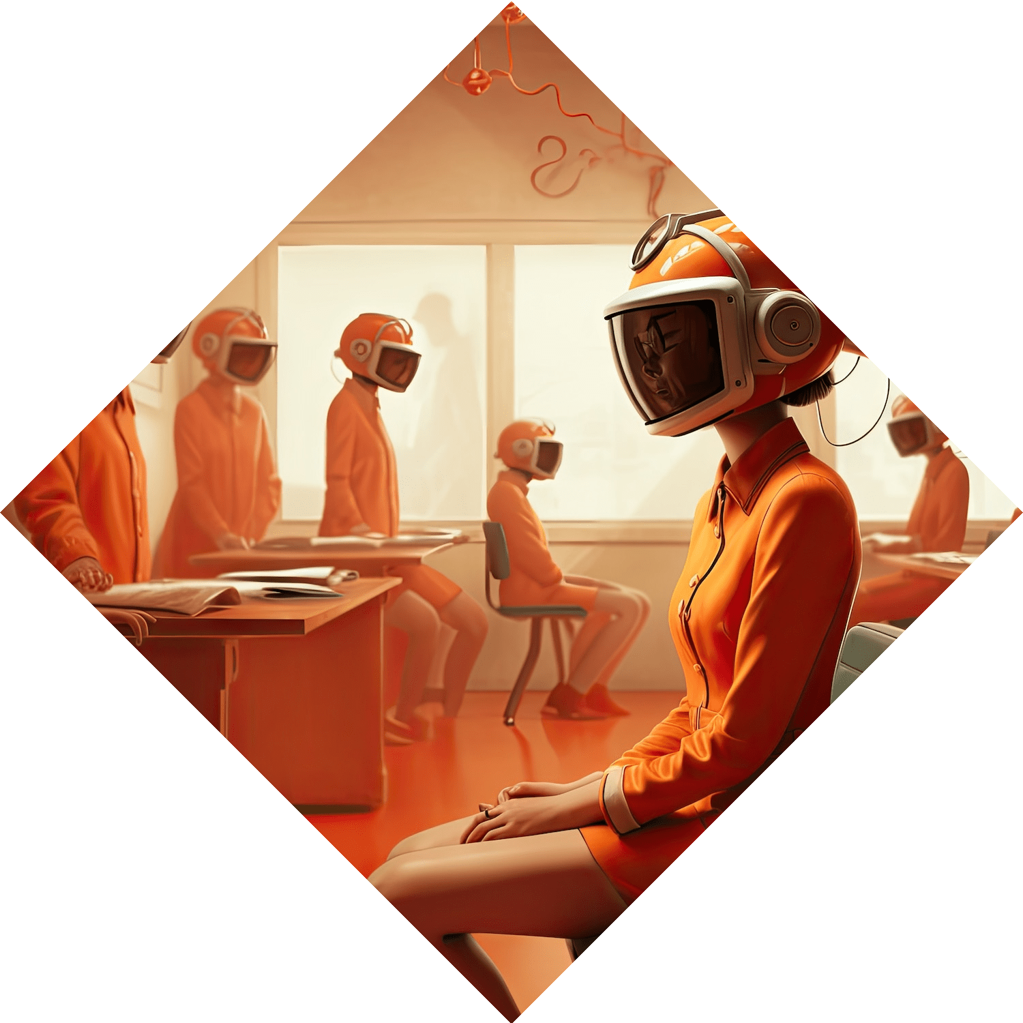

The Reality Revolution: Navigating the World of AR, VR, MR, and XR
By Dhatchanamoorthy S

Slide 2
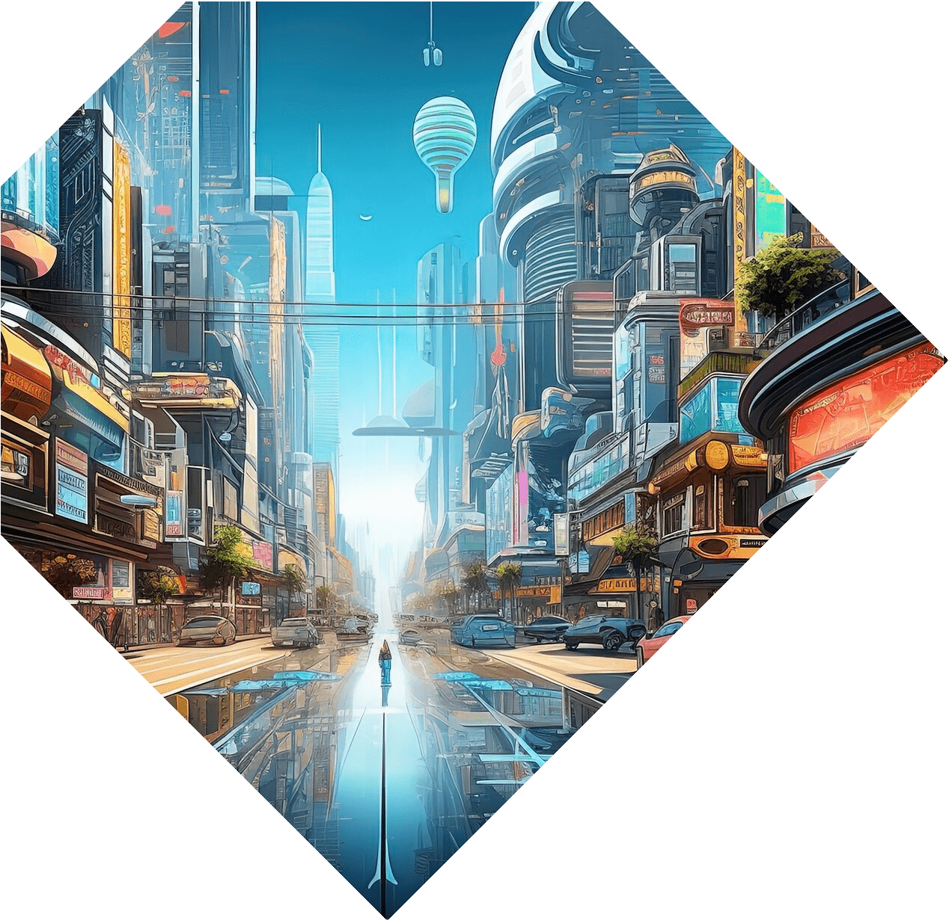
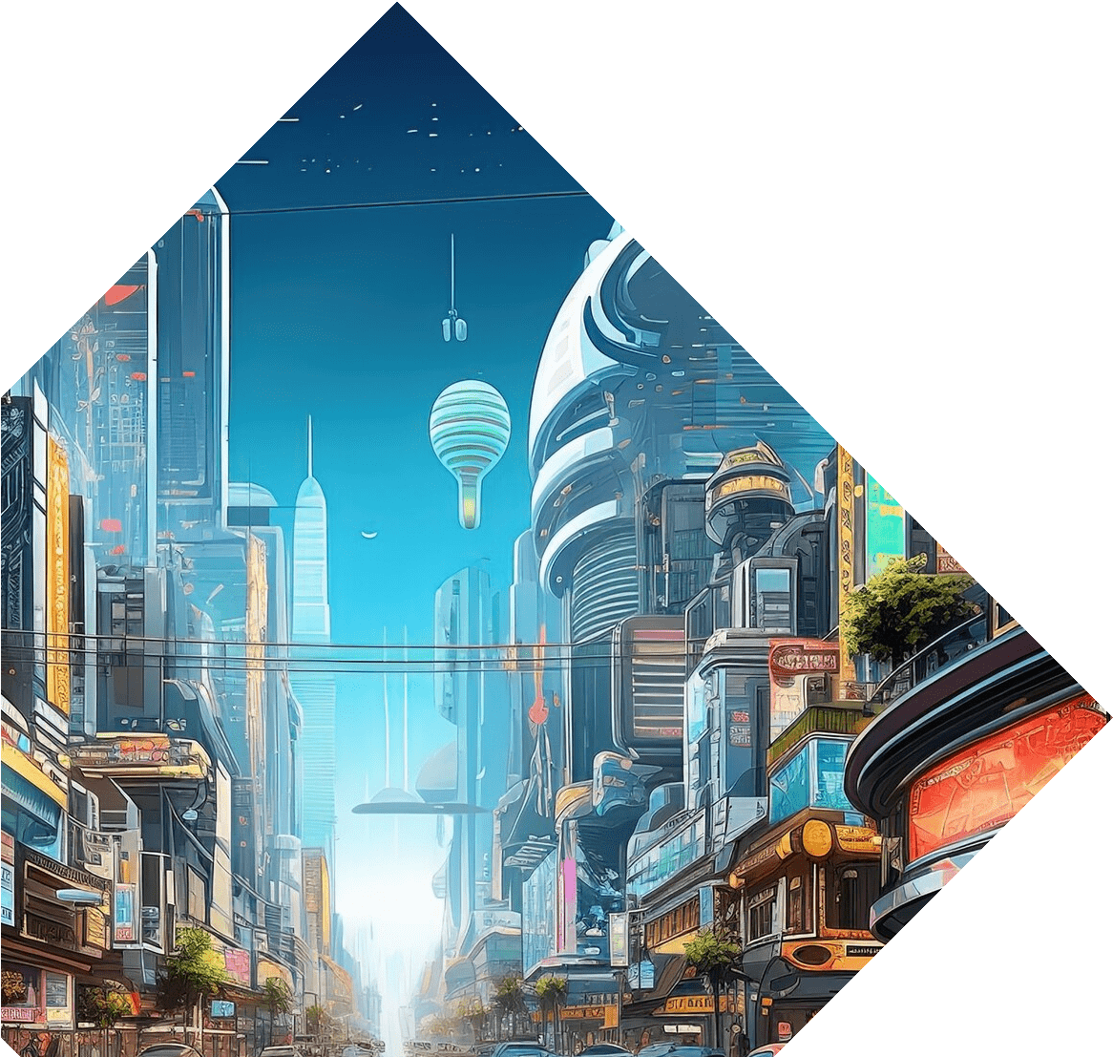
Welcome to the Reality Revolution
Discover the , and
XR and how they are reshaping our world. Get ready to explore the creative possibilities and endless opportunities in this immersive realm.

Slide 3
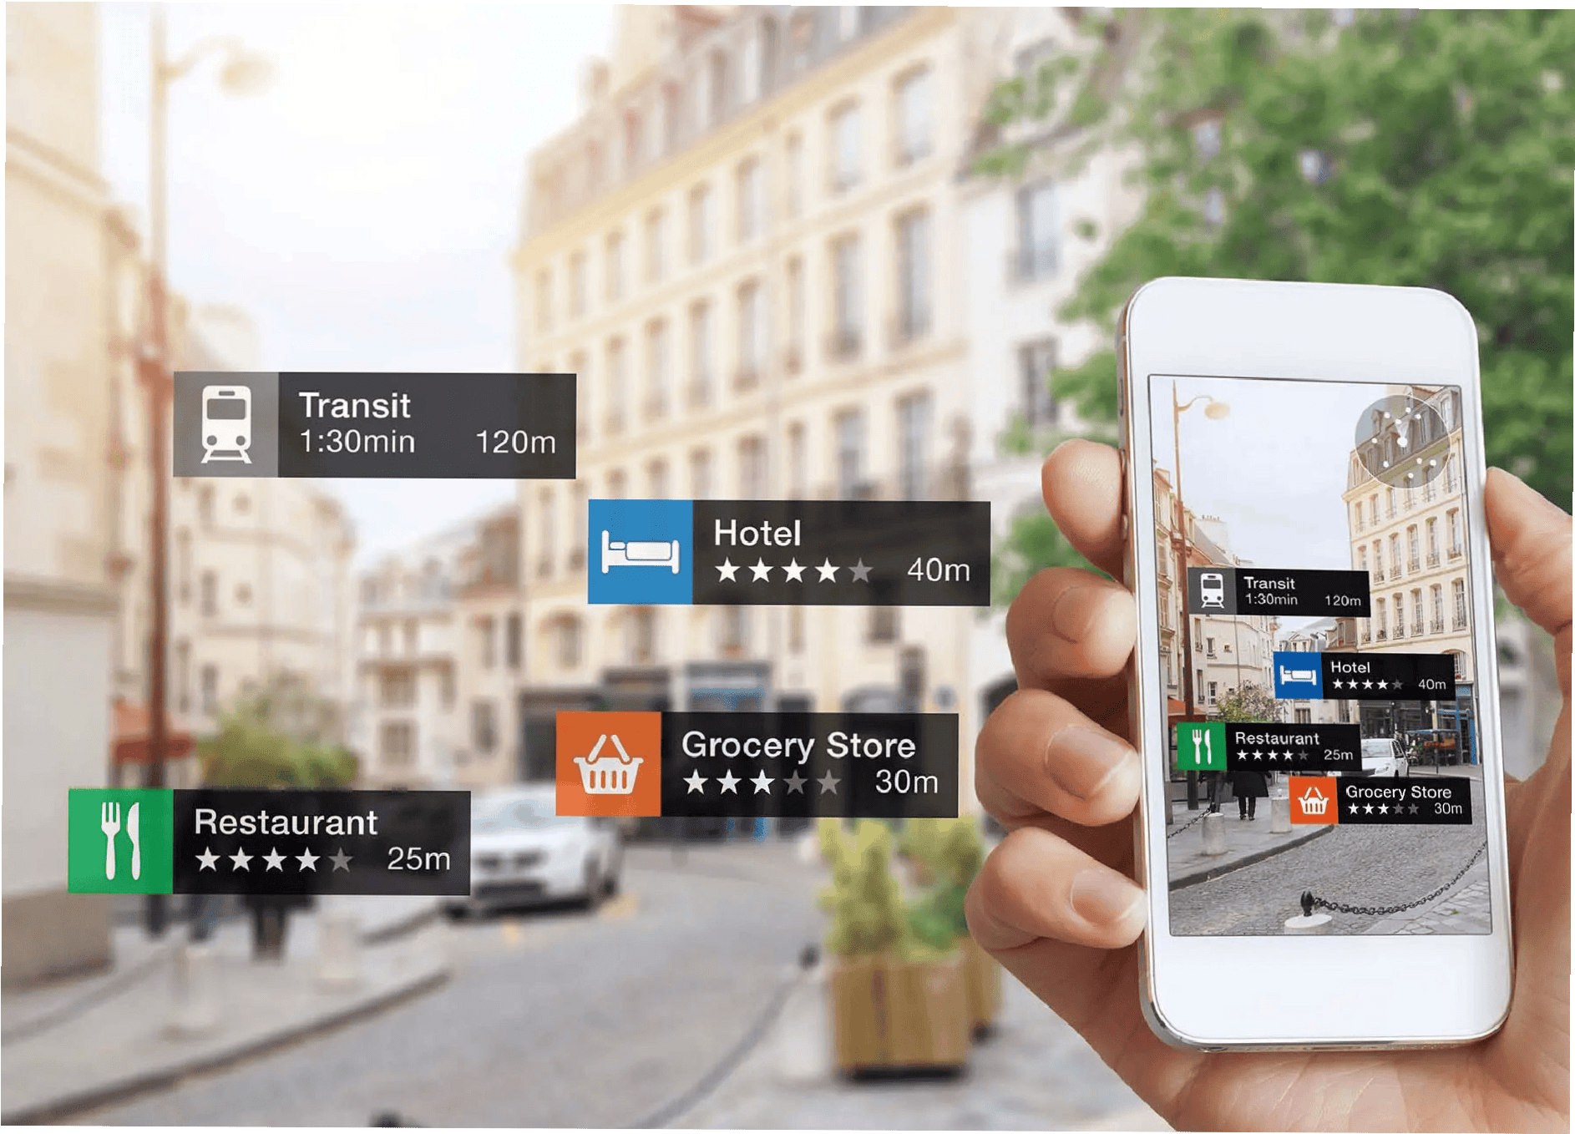
Understanding Augmented
Reality (AR)
AR is the technology that overlays digital content on top of the real world through a phone or a head- worn device, such as glasses or a
headset.

Slide 4
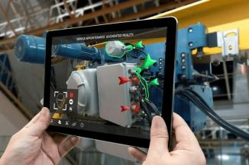
Real - time usage of Augmented Reality (AR)
Augmented reality (AR) is revolutionizing industries like education, healthcare, and retail.
Its immersive experiences enhance learning, aid in surgical procedures, and improve customer engagement.
AR apps like Pokemon Go have popularized the technology, showcasing its potential for entertainment and marketing.

Slide 5
Real - time usage of Augmented Reality (AR)

Slide 6
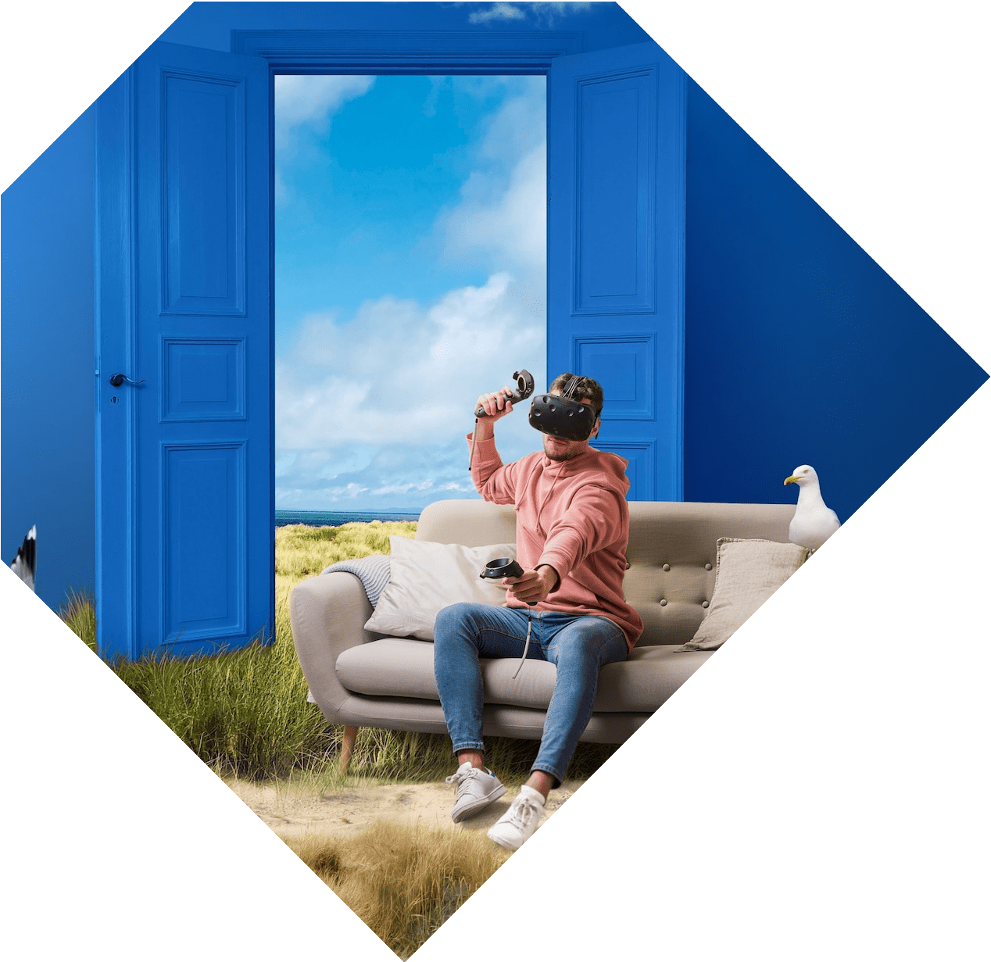
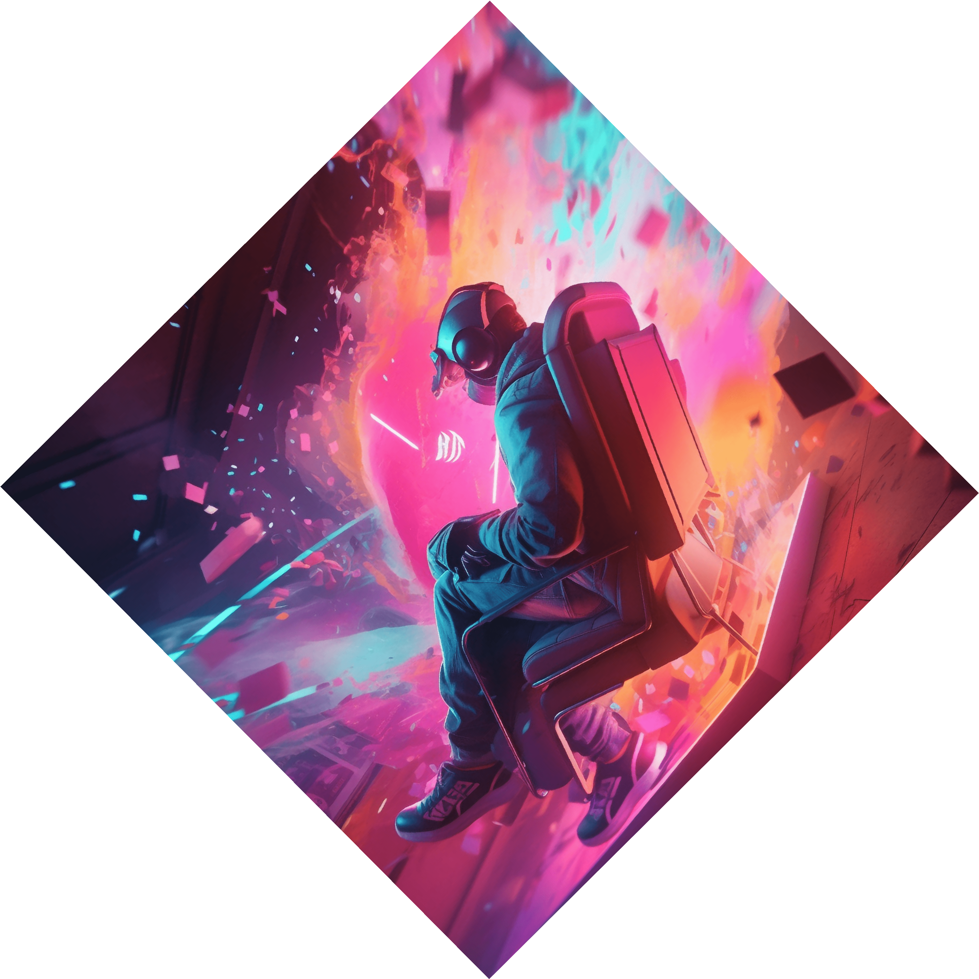
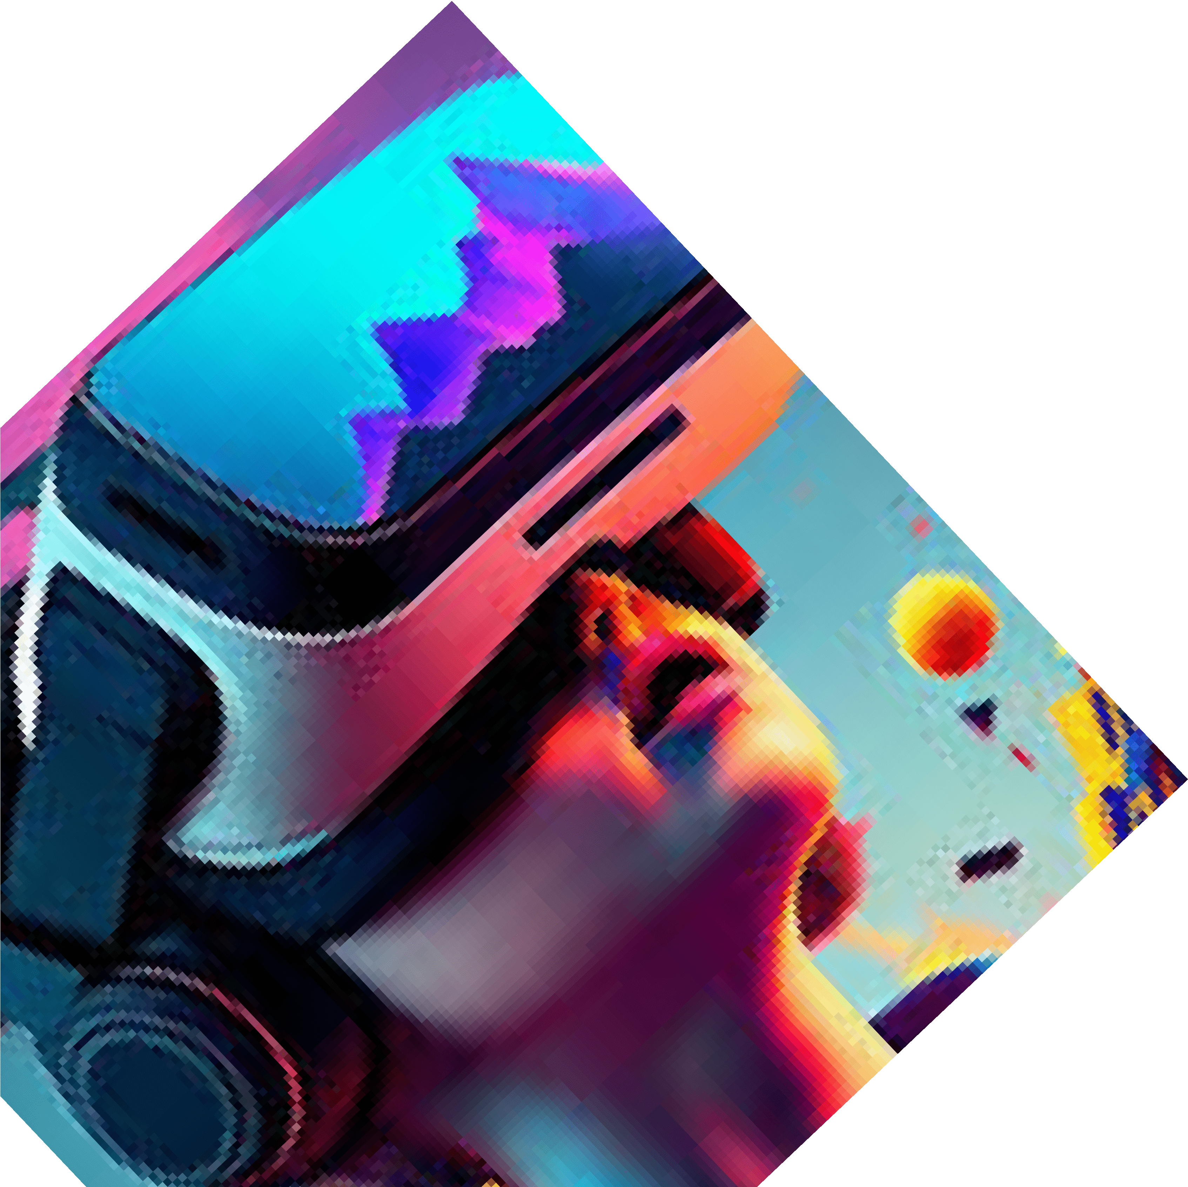
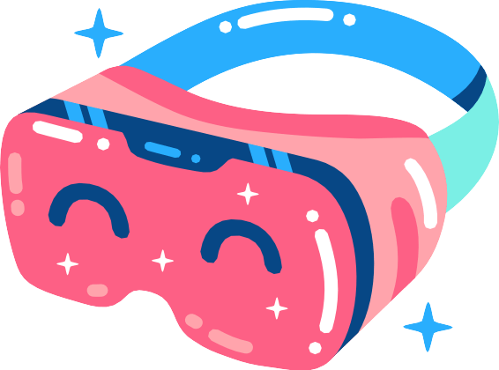
Venturing into Virtual Reality (VR)
VR immerses the user in a virtual environment to create believable experiences, whether they immerse the user in a
real-life situation or a
creative imaginary experience.

Slide 7
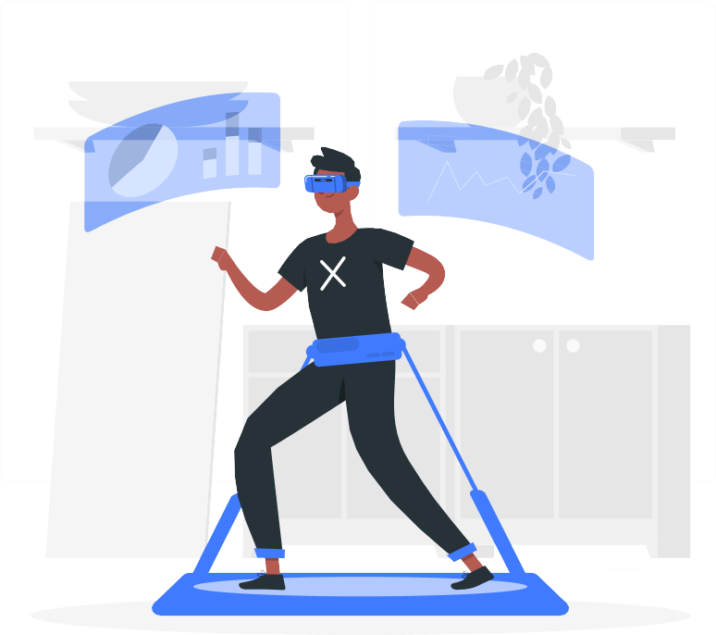
Real-Time usage of Virtual Reality (VR)
VR is a safe way to simulate dangerous situations for training purposes. Firefighters, pilots, astronauts and police can learn in a controlled environment before going into the field. Immersive experience narrows timeframes so trainees can more quickly become professionals.
Many real-life hobbies are now available in VR, and the immersive, social experience makes them all the more enjoyable and accessible. If you're a fan of cultural activities, you can visit museums such as the Natural History Museum in London or if you're into sports, you can play golf or football in VR.

Slide 8







Real - time usage of Virtual Reality (VR)

Slide 9
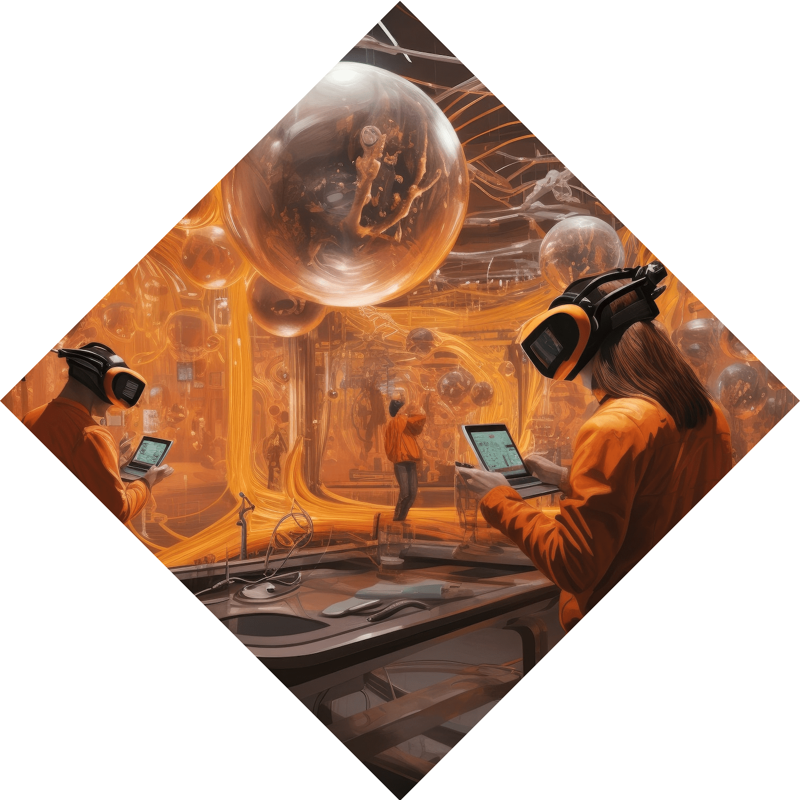
The Magic of Mixed Reality (MR)
MR brings the best of both AR and VR together by capturing the real- world through a series of cameras and sensors
– then projecting it on a display before your eyes. In MR, virtual objects are seamlessly integrated into reality for completely new experiences.

Slide 10
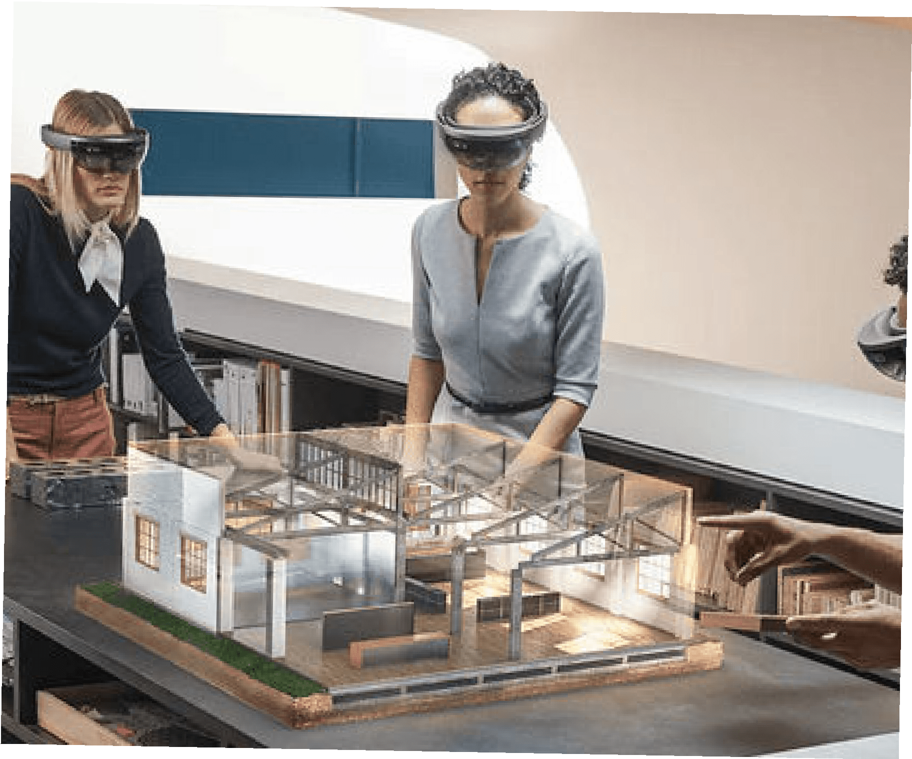
Real-Time usage of Mixed Reality
(MR)
Employees can collaborate from anywhere using mixed reality.
Translation applications seamlessly overcome language barriers in real time.
Mixed-reality meetings surpass the experience of video conferencing and Skype calls.
Japan Airlines employs HoloLens for engineer training without hangar visits.
NASA's OnSight software, developed with Microsoft, virtually transports scientists and engineers to Mars while they remain on Earth.

Slide 11
Real - time usage of Mixed Reality (MR)

Slide 12

Unveiling Extended Reality (XR)
XR is an emerging umbrella term for all the immersive technologies.
The ones we already have today—augmented reality (AR), virtual reality (VR), and mixed reality (MR)plus those that are still to be created.
All immersive technologies extend the reality we experience by either blending the virtual and “real” worlds or by creating a fully immersive experience.
Recent research revealed that more than 60% of respondents believed XR will be mainstream in the next five years. To get a better picture of XR, let’s review each of the existing technologies that exist today.

Slide 13
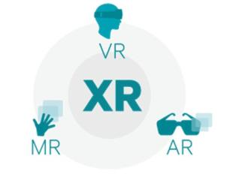
Discombobulated with these technical words?
Let’s make it simple.
XR is a mixture of AR, VR, and MR in the approx. proportion of say 36%, 38%, and 26% respectively.

Slide 14
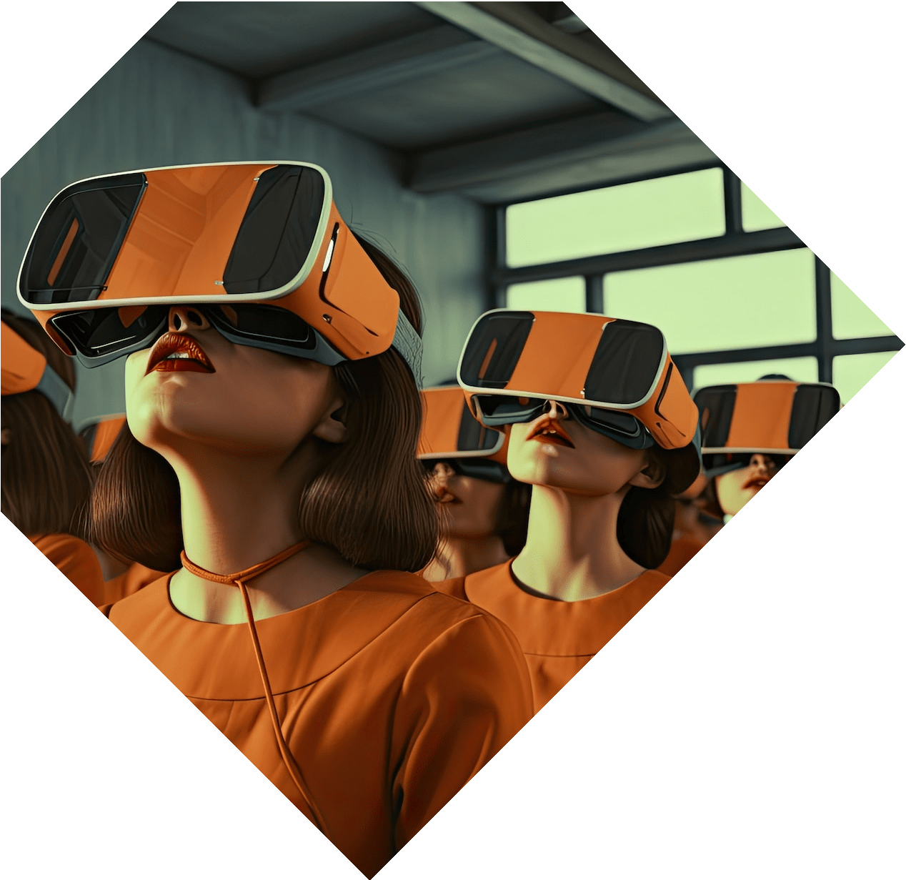


Common disadvantages with them
Technical limitations cost Security concerns Privacy issues
Latency
Health concerns Usability challenges

Slide 15



Technologies used for development
Widely used for AR, MR, XR, and VR development. Supports platforms like Oculus, HoloLens, Magic Leap, and ARKit/ARCore.
Features: Real-time 3D development, extensive asset store, community support.

Slide 16


Technologies used for development
Powerful engine for creating high-fidelity AR/VR experiences.
Supports Oculus, HoloLens, ARKit/ARCore, Magic Leap.
Features: Photorealistic rendering, Blueprint visual scripting, strong support for VR.

Slide 17
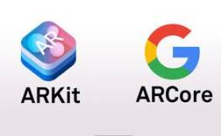


AR SPECIFIC TECHNOLOGIES
ARKit (Apple)
Specifically for developing AR applications on iOS devices. Features: Motion tracking, environmental understanding, light estimation.
ARCore (Google)
Google's platform for building AR experiences on Android devices.
Features: Motion tracking, environmental understanding, light estimation.

Slide 18


OTHER Development Platforms and SDKs
Vuforia
Microsoft Mixed Reality Toolkit (MRTK) Magic Leap
WebXR

Slide 19
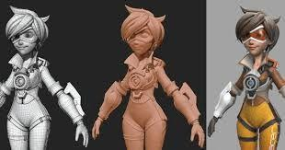
3D Modeling and Design Tools
Blender
Maya 3ds Max
Cinema 4D

Slide 20

Prototyping and Interaction Design Tools
Adobe Aero
Hardware SDKs and APIs
SketchUp
Figma
Oculus SDK SteamVR HoloLens SDK

Slide 21
Thanks!
Do you have any questions?
Appreciate your time and attention.

